Slide 1

Payroll in the Cloud
Why would you and what you need to watch out for

Slide 2



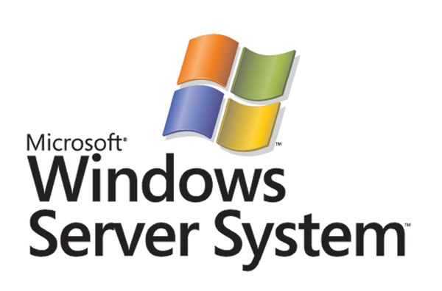

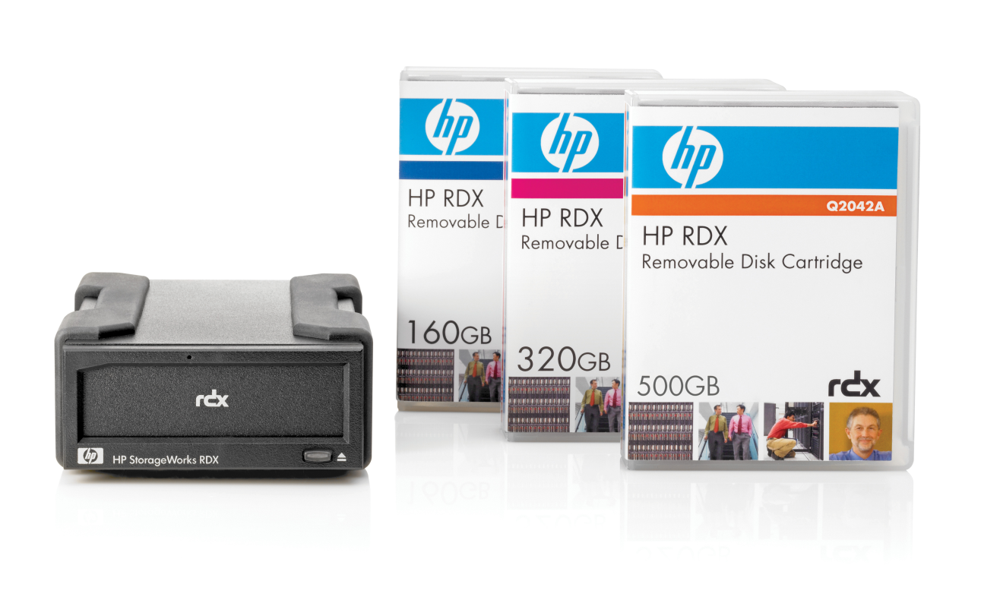
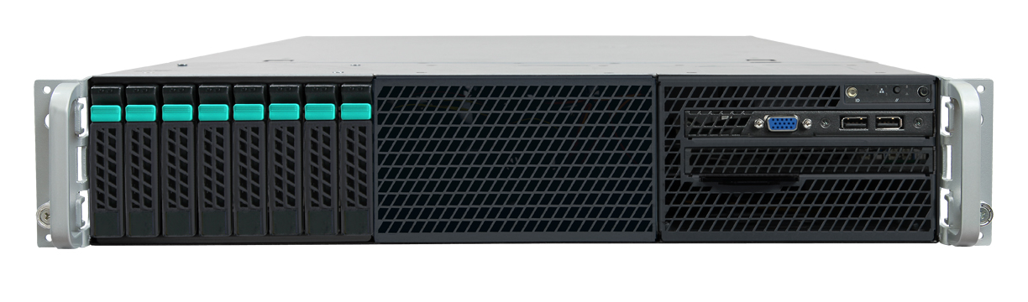
Up until now you needed…
Hardware Support Agreement
1. Definitions and Interpretations
1.1 In these terms and conditions:
“Agreement” means this Master Services Agreement and any Supplementary Agreement between the Customer and Datacom for the provision of Works by Datacom;
“Business Day” means a day (other than a Saturday or Sunday or statutory holiday) on which business is conducted in Auckland, New Zealand;
“Confidential Information” of a Party (a “Disclosing Party”) means any information treated by the Disclosing Party as confidential and:
(i) which is disclosed by or on behalf of the Disclosing Party to the other Party (a “Receiving Party”); and/or
(ii) which is obtained through observations made by the Receiving Party in connection with (directly or indirectly) this Agreement,
whether before or after the date of this Agreement and includes all analyses, compilations, studies and other documents which contain or otherwise reflect or are derived from such information;
“Customer” means the person to whom the Works are to be supplied as may be more particularly defined in a Supplementary Agreement;
“Datacom IP” means any Pre-existing IP owned by Datacom and excludes the Third Party IP and the New IP;
“Deliverable” means any item identified as a Deliverable in a Supplementary Agreement;
“Direct Losses” means all damage, losses, liabilities, claims, actions, costs, expenses (including the cost of legal or professional services, legal costs being on an agent/client, client paying basis), proceedings, demands and charges whether arising under statute, contract or at common law but, to avoid doubt, excluding Indirect Losses;
“Dispute” means any dispute or difference arising between the Parties in connection with this Agreement;
Operating System Support Agreement
1. Definitions and Interpretations
1.1 In these terms and conditions:
“Agreement” means this Master Services Agreement and any Supplementary Agreement between the Customer and Datacom for the provision of Works by Datacom;
“Business Day” means a day (other than a Saturday or Sunday or statutory holiday) on which business is conducted in Auckland, New Zealand;
“Confidential Information” of a Party (a “Disclosing Party”) means any information treated by the Disclosing Party as confidential and:
(i) which is disclosed by or on behalf of the Disclosing Party to the other Party (a “Receiving Party”); and/or
(ii) which is obtained through observations made by the Receiving Party in connection with (directly or indirectly) this Agreement,
whether before or after the date of this Agreement and includes all analyses, compilations, studies and other documents which contain or otherwise reflect or are derived from such information;
“Customer” means the person to whom the Works are to be supplied as may be more particularly defined in a Supplementary Agreement;
“Datacom IP” means any Pre-existing IP owned by Datacom and excludes the Third Party IP and the New IP;
“Deliverable” means any item identified as a Deliverable in a Supplementary Agreement;
“Direct Losses” means all damage, losses, liabilities, claims, actions, costs, expenses (including the cost of legal or professional services, legal costs being on an agent/client, client paying basis), proceedings, demands and charges whether arising under statute, contract or at common law but, to avoid doubt, excluding Indirect Losses;
“Dispute” means any dispute or difference arising between the Parties in connection with this Agreement;
Database Support Agreement
1. Definitions and Interpretations
1.1 In these terms and conditions:
“Agreement” means this Master Services Agreement and any Supplementary Agreement between the Customer and Datacom for the provision of Works by Datacom;
“Business Day” means a day (other than a Saturday or Sunday or statutory holiday) on which business is conducted in Auckland, New Zealand;
“Confidential Information” of a Party (a “Disclosing Party”) means any information treated by the Disclosing Party as confidential and:
(i) which is disclosed by or on behalf of the Disclosing Party to the other Party (a “Receiving Party”); and/or
(ii) which is obtained through observations made by the Receiving Party in connection with (directly or indirectly) this Agreement,
whether before or after the date of this Agreement and includes all analyses, compilations, studies and other documents which contain or otherwise reflect or are derived from such information;
“Customer” means the person to whom the Works are to be supplied as may be more particularly defined in a Supplementary Agreement;
“Datacom IP” means any Pre-existing IP owned by Datacom and excludes the Third Party IP and the New IP;
“Deliverable” means any item identified as a Deliverable in a Supplementary Agreement;
“Direct Losses” means all damage, losses, liabilities, claims, actions, costs, expenses (including the cost of legal or professional services, legal costs being on an agent/client, client paying basis), proceedings, demands and charges whether arising under statute, contract or at common law but, to avoid doubt, excluding Indirect Losses;
“Dispute” means any dispute or difference arising between the Parties in connection with this Agreement;
Payroll Software Support Agreement
1. Definitions and Interpretations
1.1 In these terms and conditions:
“Agreement” means this Master Services Agreement and any Supplementary Agreement between the Customer and Datacom for the provision of Works by Datacom;
“Business Day” means a day (other than a Saturday or Sunday or statutory holiday) on which business is conducted in Auckland, New Zealand;
“Confidential Information” of a Party (a “Disclosing Party”) means any information treated by the Disclosing Party as confidential and:
(i) which is disclosed by or on behalf of the Disclosing Party to the other Party (a “Receiving Party”); and/or
(ii) which is obtained through observations made by the Receiving Party in connection with (directly or indirectly) this Agreement,
whether before or after the date of this Agreement and includes all analyses, compilations, studies and other documents which contain or otherwise reflect or are derived from such information;
“Customer” means the person to whom the Works are to be supplied as may be more particularly defined in a Supplementary Agreement;
“Datacom IP” means any Pre-existing IP owned by Datacom and excludes the Third Party IP and the New IP;
“Deliverable” means any item identified as a Deliverable in a Supplementary Agreement;
“Direct Losses” means all damage, losses, liabilities, claims, actions, costs, expenses (including the cost of legal or professional services, legal costs being on an agent/client, client paying basis), proceedings, demands and charges whether arising under statute, contract or at common law but, to avoid doubt, excluding Indirect Losses;
“Dispute” means any dispute or difference arising between the Parties in connection with this Agreement;

Slide 3
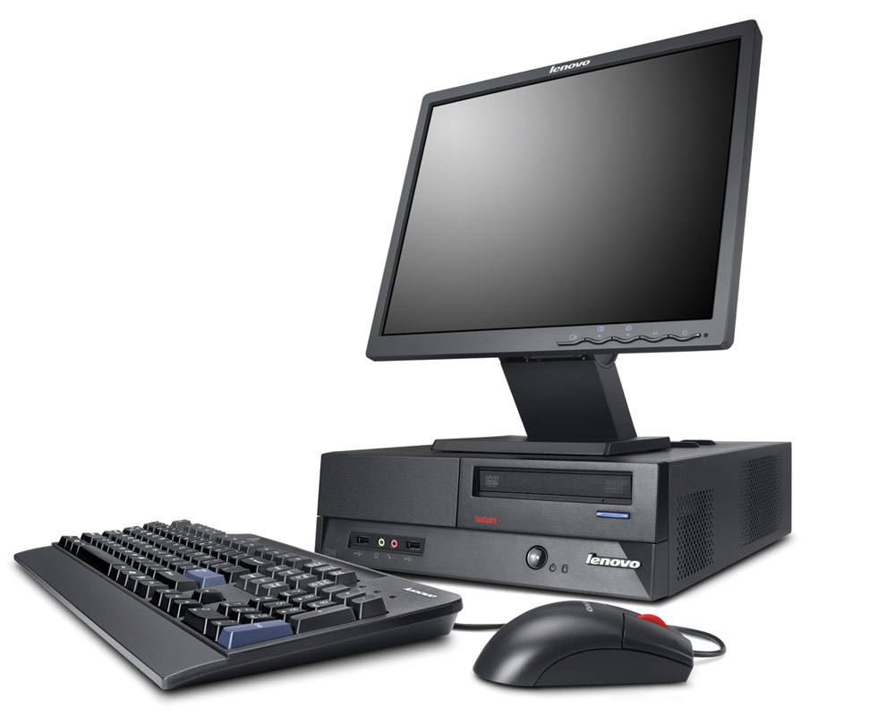
Now all you need is…

Slide 4






Software As A Service

Slide 5
Multi-tenanting

Slide 6
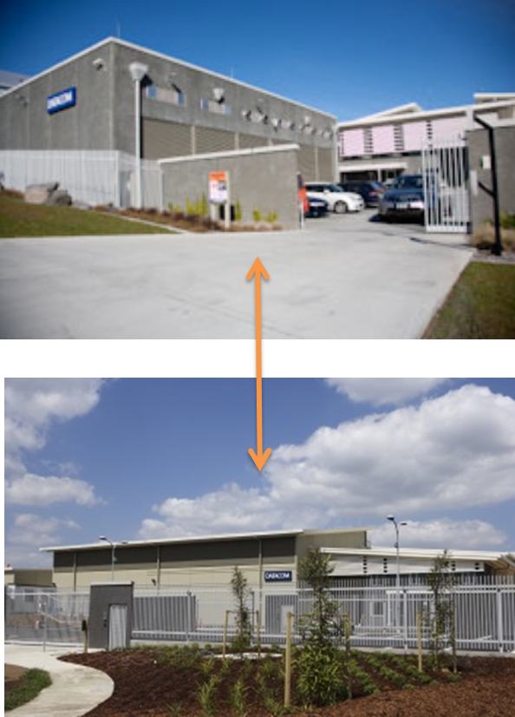
The advantages of scale

Slide 7

The advantages of scale

Slide 8
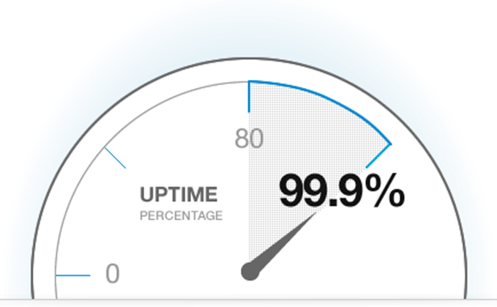
The advantages of scale

Slide 9

The advantages of scale

Slide 10
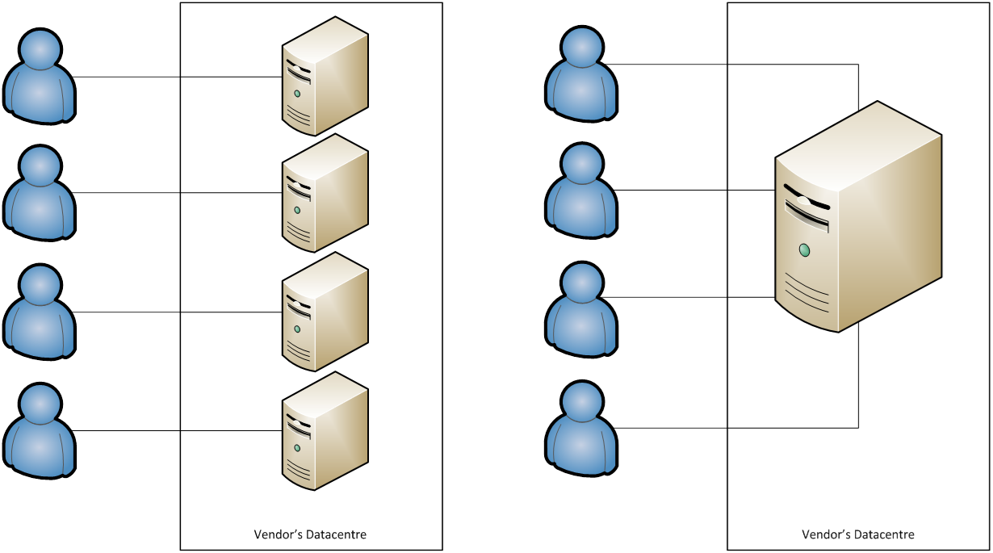
Upgrades

Slide 11
Connectedness

Slide 12

Access from anywhere

Slide 13
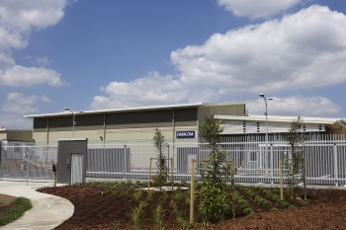
Data security

Slide 14
Checklist for cloud applications
Term
Scale up/down
Portability of data
Disaster recovery
Upgrades
Security
Company stability
Ability to customise
Internet bandwidth

Slide 15
Cloud Benefit Summary
Preserve capital
Save money
Avoid IT complexity
Scalability
DR plan
Avoid constant upgrades & testing
Higher availability
Automate IRD filing
Automate banking
Flexibility to change when you need to
Data security
Access from anywhere

Slide 16
Cloud Computing
Gartner – Cloud computing is the #1 technology that you can’t afford to ignore
Gartner – 77% of organisations have plans to move to cloud computing
Datacom has been offering cloud payroll since 2000

