Slide 1

From Whoa to Go
Migrating Employees to a New Payroll System
NZPPA Annual Conference September 2013
Notes:
Thank you for that introduction. I would just like to point out that I am no expert in payroll like all you folk here, but I have been cunning enough to surround myself with experts both inside and outside the company.

Slide 2

Contents
Who is Calder Stewart?
Why change existing payroll?
Overview of implementation process
Things to consider
Tips and Tricks
Notes:
To begin with I’m going to run you through a little bit of background to our project, and then we will run a bit of a tag team interview session.

Slide 3
Who Is Calder Stewart?
Founded in 1955 - family owned company
Commercial and industrial construction specialists
Head Office Milton
Operate South Island
360 Staff
Company
Service Divisions
Notes:
Essentially two good mates got together and started building sheds for farmers in South Otago.
58 years on you will find Calder Stewart buildings throughout New Zealand, employing 360 staff plus a large number of contractors.
Demonstrating the commitment to the area where it all began, Head Office is situated 2 km north of the small town of Milton.

Slide 4
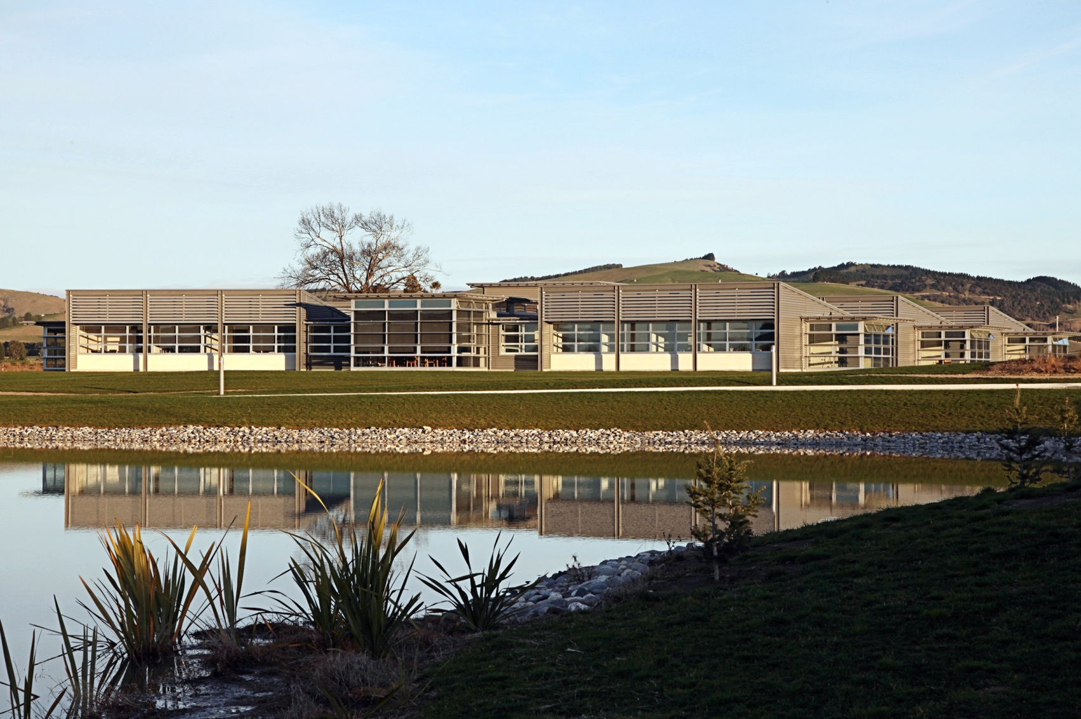
Head Office
Revolution Hills - Milton
Notes:
Well, if you are a Construction Company you have to fly the flag!

Slide 5
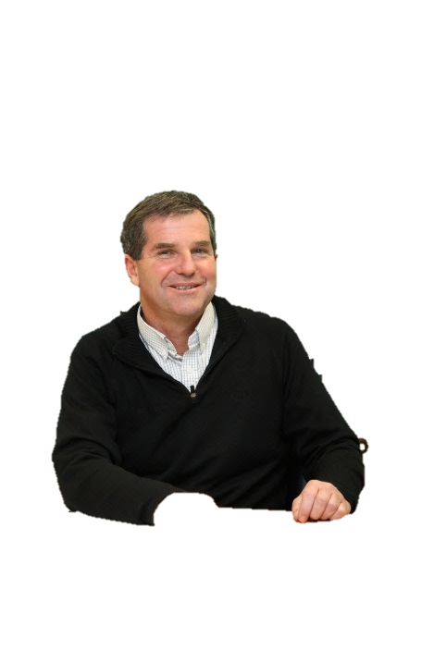


Our Divisions
Construction - commercial, industrial and farm building construction
Roofing – manufacture of roofing products
Precast – manufacture of precast concrete panels for Construction
Steel – fabrication of steel for Construction
Distribution - trucking service from factories to building sites, delivering goods and equipment and logging transportation
ReoXpress – manufacture of reinforcing products for Construction and Precast
Development - property development/land banking – delivers Design & Build concepts to clients
Forestry - develops and maintains forestry blocks
Operational Support - delivers support and administration service to company (IT, Health & Safety, HR, Financial and Administration)
Company Structure
Notes:
So the growth came about like this, but not necessarily in this order:
Why are we paying somebody else for our roofing material?
Why are we paying somebody else for our precast panels?
Why are we paying somebody else for our structural steel?
Why are we paying somebody else to transport plant and materials to site?
Why are we paying somebody else to manufacture reinforcing steel? Oh, and, while we are at it, why don’t we design our very own unique product and sell it to other companies as well?
Why are we waiting for landowners to ask us to build on their land?
Why are we…., mm, this one doesn’t quite fit the pattern, but being the second largest owner of private forestry next to Ngai Tahu in the South Island is no mean feat.
Operational Support – aka corporate services, the division I belong to
Oh, and, this next one doesn’t quite fit the pattern either………….

Slide 6
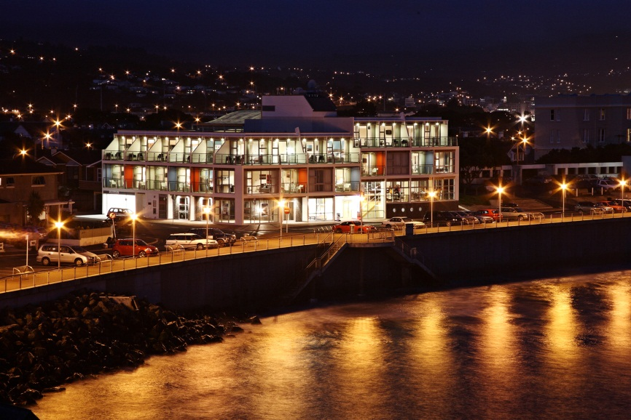
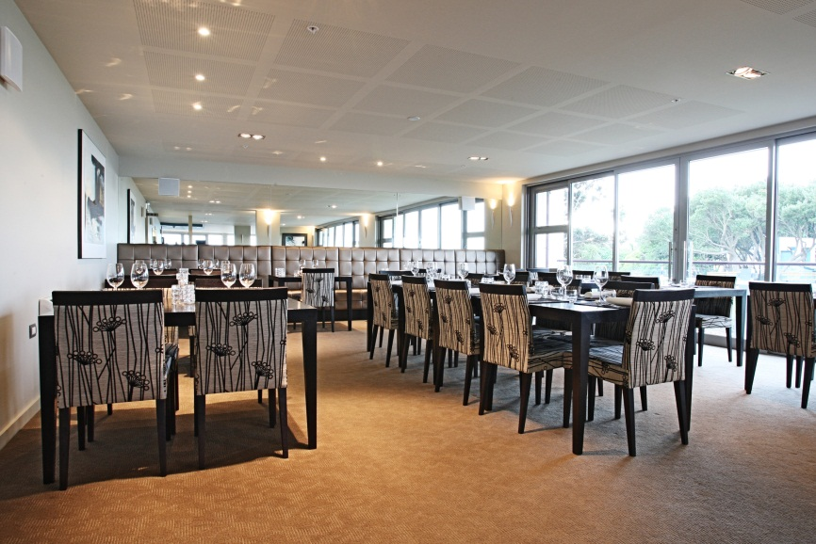

A Random Hotel
Notes:
Hotel St Clair – incorporating our flagship restaurant – Pier 24 led by Celebrity Chef – Michael Coughlin
Yes we built it, and now we own it and run it.

Slide 7
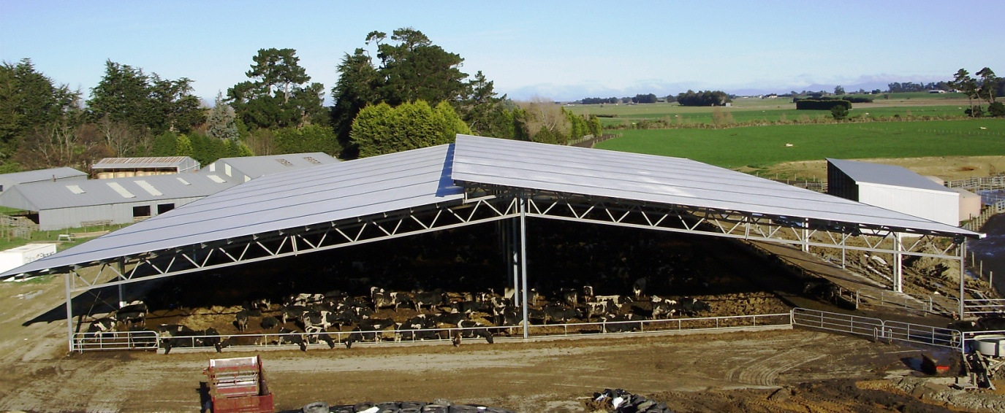
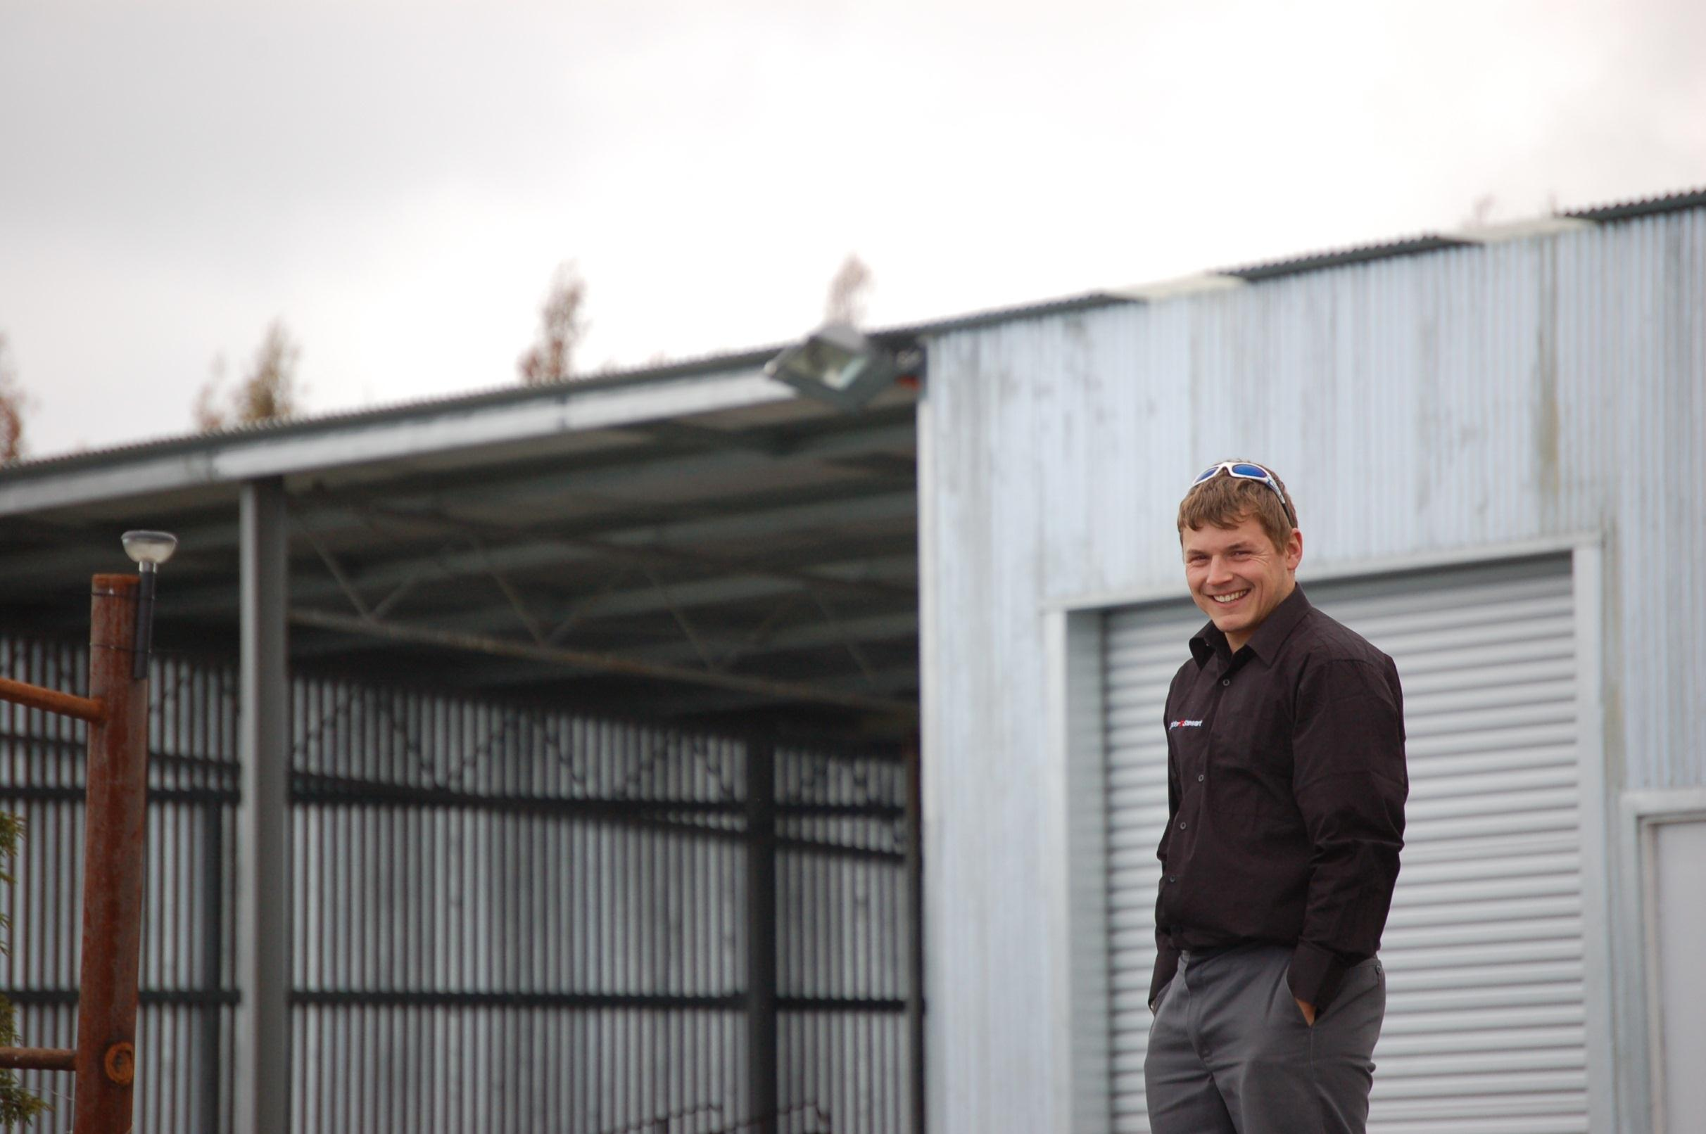
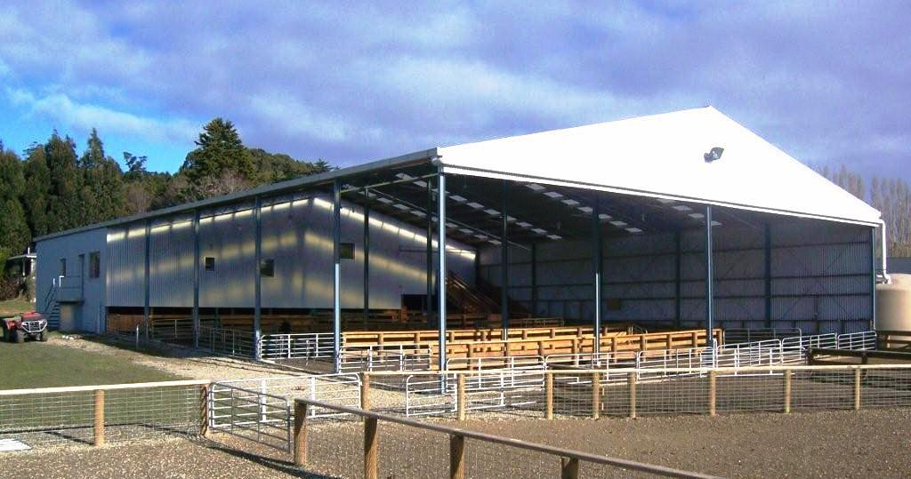
Farm Buildings
Notes:
Predominantly constructing in steel and tilt slab, here are just a few of our end products.

Slide 8
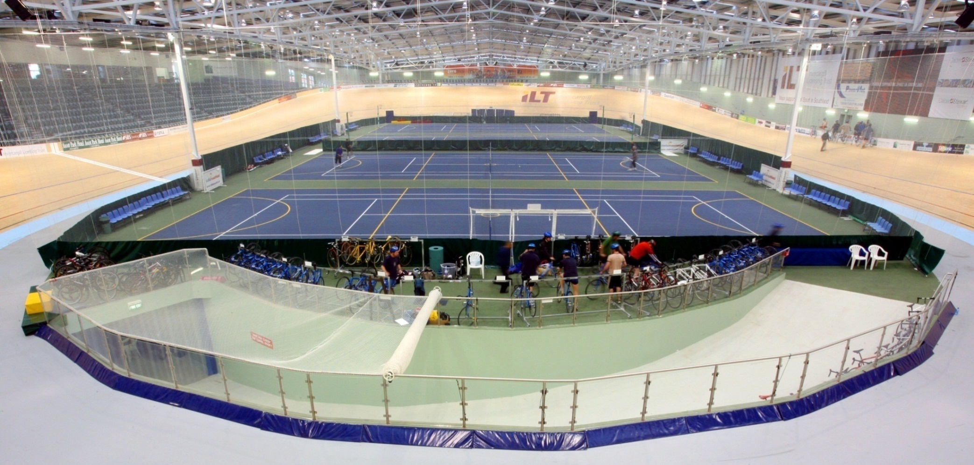
ILT Velodrome - Invercargill
New Zealand’s first indoor timber track velodrome
Winner – 2007 RMB, Tourism and Leisure
Notes:
And no, this is not the Invercargill Stadium which collapsed under the snow 2 years ago, we didn’t build that, this one is just fine!

Slide 9
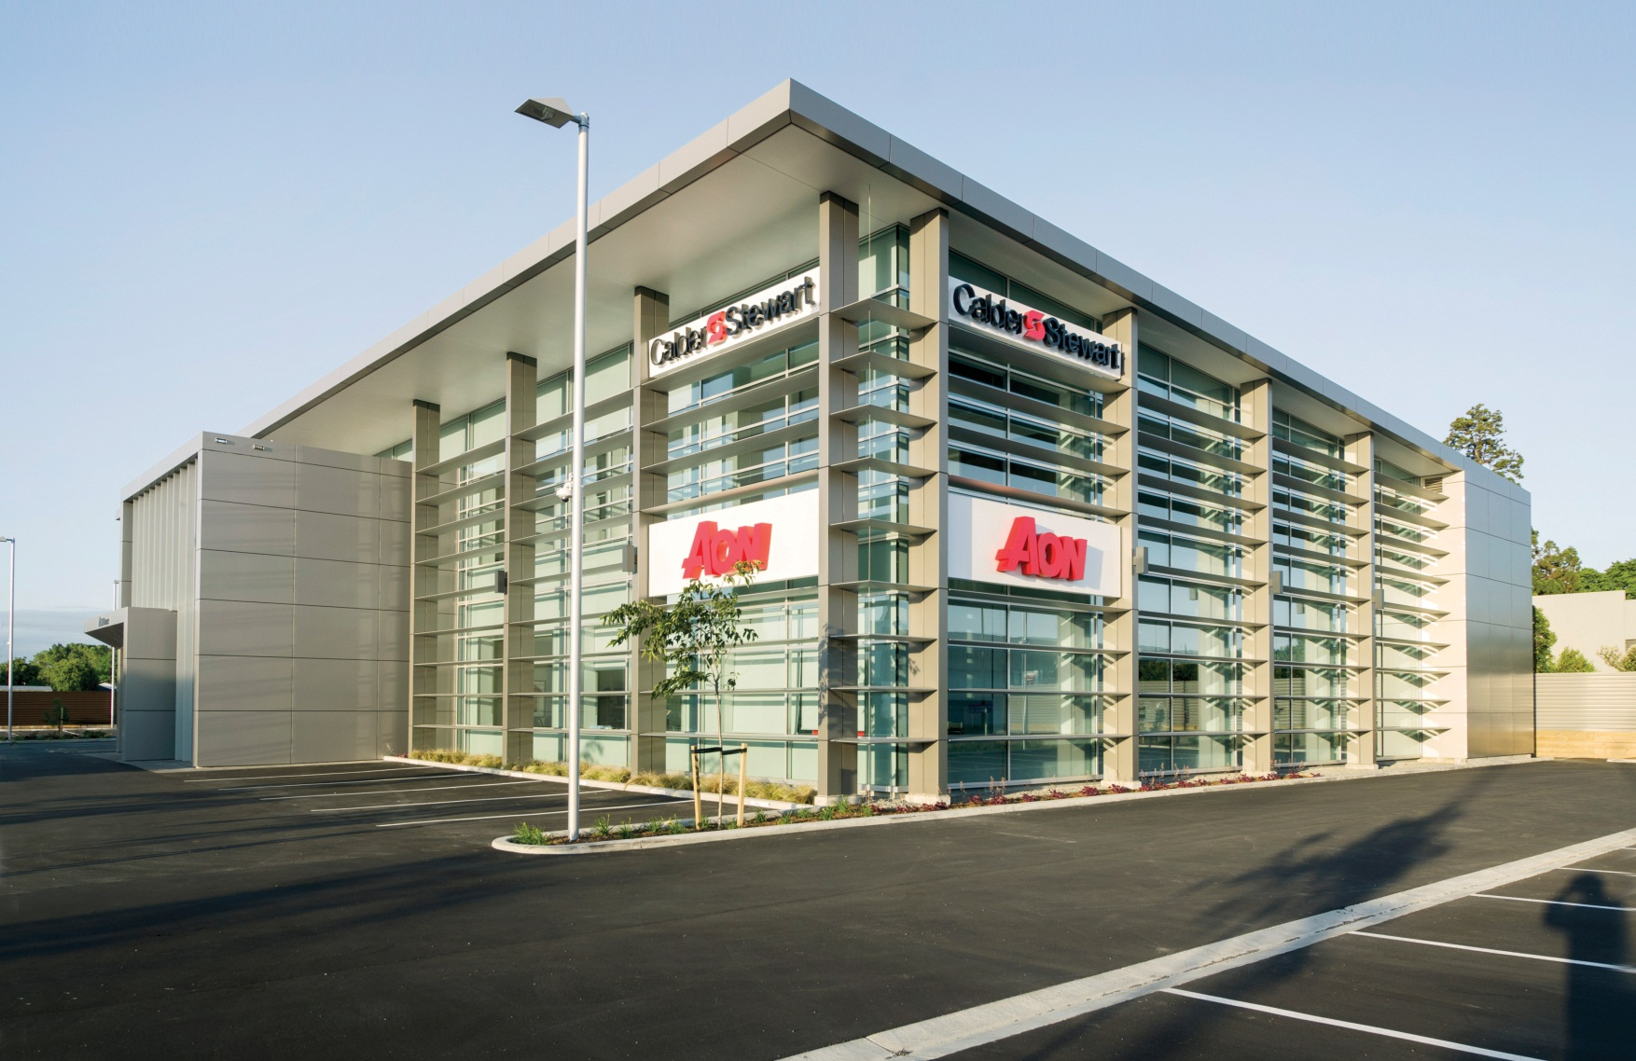
Christchurch Office – Aon House

Slide 10
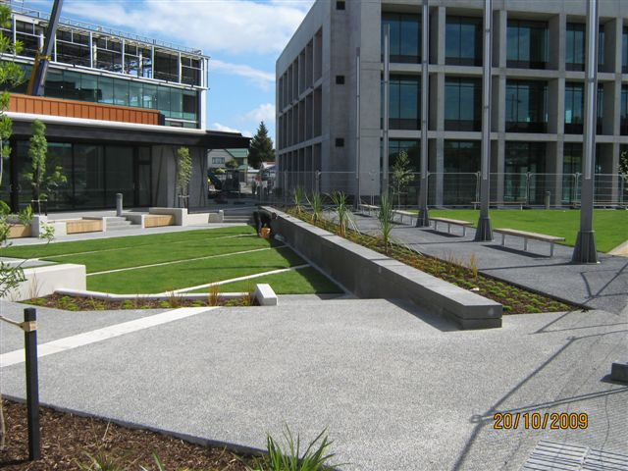
Hazeldean Business Park

Slide 11
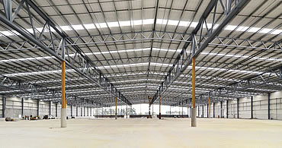
Fonterra Drystore - Darfield

Slide 12

Sky City
Notes:
And you might recognise this one, we did the copper cladding for Sky City, we also did the cladding for Te Papa. Most recently here in Auckland we have completed a build for TopMaq.

Slide 13

The Need for Change
Outsourced Since 1955
Complete review of all payroll process undertaken, tabled with board April 2012
July 2012 board approval to bring in house
Board instructed Go Live to coincide with FYE - APRIL 2013!!!
Notes:
Ok, that’s enough pretty buildings, let’s talk payroll
Outsourcing gave us limited access to our employee data and there were a number of flaws, frustrations and bottlenecks in our processes.
I had come from an organisation where payroll sat within finance with a dotted line to HR and was astounded that a company our size did not have full control over this core function.
So I foolishly put my hand up and suggested I review the whole payroll process. The full report was completed by the end of March 2012, and the findings presented to the Board of Directors in April 2012. The key recommendation was to bring this core business function in house and this recommendation was accepted. There was possibly a little bit of bias in my review as having previously been involved in a successful payroll implementation I was keen to do it all over again and use what I’d learned. However I could also clearly see the benefits we would gain. Besides, isn’t that how everyone else does a review? Decide your outcome first and then bolster your argument in behind?
Anyway, despite being known for being innovative and entrepreneurial, as a company this was a very big deal for us.

Slide 14
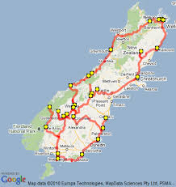
Let’s Go!
Notes:
Ok, so personally I am pretty sick of everyone going on journeys, I prefer to think of this adventure as a laid back and relaxing road trip. Well not exactly laid back, there were a number of nights where I dreamt about data capture!

Slide 15

Implementation Checklist - The CSI Way
KISS – does the proposed solution meet this criteria?
Relationship preservation – how?
ROI – must be measureable and attractive!
Notes:
We underpinned everything with our over-riding KISS principle
The relationship with the outsourcer is complex. The company accountant since 1955 they would still be providing accounting services so we couldn’t just thumb our noses at them. Careful planning went into our communications and timing.
The board members demanded hard data on the proposed savings. This was projected to be in excess of $213k per annum, which as well as the fees we were charged, also included halfing our internal administration costs. I’m sure you will agree that’s not insignificant .

Slide 16
Execution & Implementation
RFP
Evaluation
Vendor Demos
Site Visits
Selection of Preferred Vendor
Notes:
So we began by deciding what was important to us not only in a system, but in a partner.
Obviously the system had to be legislatively compliant, but it needed to be simple, user friendly and smart. A number of meetings were held with key stakeholders including IT and Finance and from these we identified what was to be included in the RFP.
As to the partner? It was crucial that they understood our business and our culture. Previous IT implementations had fallen down because of a lack of understanding so this was not negotiable. As it was, because of this history we were going to be up against the doubting Thomases anyway so I was determined to prove that this could be a smooth and seamless process.

Slide 17
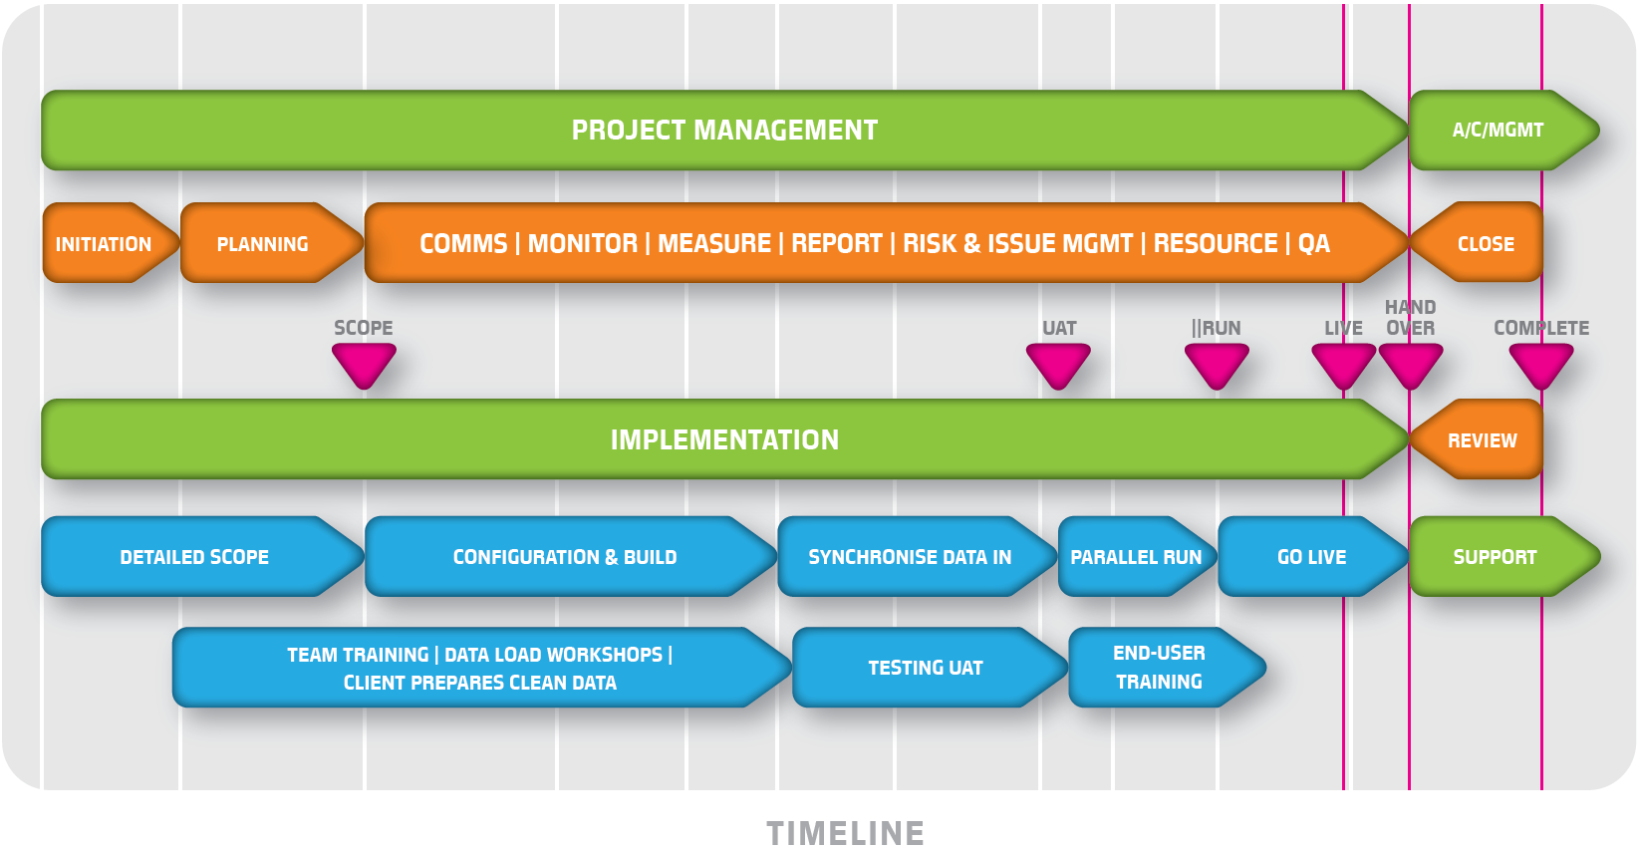
Execution & Implementation
Notes:
The implementation team’s view of the overall process and how things fit on the timeline.

Slide 18
Things to consider
Objectives and definition of success
Measuring return on investment
Timing is everything – sometimes
Getting accurate data
User acceptance testing challenges
Communication and change management
Notes:
Leave this slide up during the panel session

Slide 19
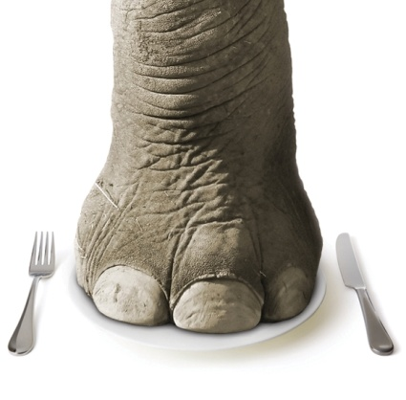
Key Lessons Learned
How do you eat an Elephant?
One bite at a time
  Break up complexity
  Choose multiple phases
  Expect it to be hard
  New skills, processes, systems, people
Notes:
If the project is getting larger, more complex and under-resourced, break it up. Multiple phases, prioritise, hire a temp. Expect it to be hard – it is complex and you are learning a whole new set of processes and skills, and dealing with new people. And ensure that the project sponsors and management understand this too.

Slide 20
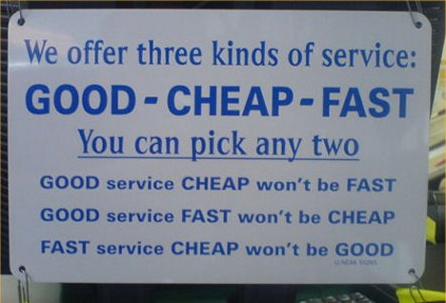
Key Lessons Learned
Good things take time
  4 month average time
  Consider leave and delays
  Don’t be afraid to say NO
Notes:
Timing and schedule: Good things take time. A typical payroll migration (200 – 2000 employees) takes 4 months. Each extra feature also adds time: Self Service, HR, Timesheeting will each add another chunk of time, depending on complexity and breadth of scope. Don’t let anyone push you towards a Go Live date you are not comfortable with. Build in gaps into the schedule for Leave and delays – it is better to have time in hand even if you don’t need it rather than vice versa.

Slide 21

Key Lessons Learned
Get started now!!
Things you think you can do later
(but will come back to bite you)
  Data extraction
  UAT testing of reports
  Employee maintenance
  Schedule deadlines
Notes:
Reporting – Critical report scoping at the start, other reports during UAT. Waiting until Parallel runs to find out that a key report is not available out of the box is too late.
Data Capture – start it immediately. Ask your old vendor to assist if possible. If you see issues with getting specific field data, tell your implementation team ASAP to check how critical the availability or timing of this data is.
Data maintenance – start ASAP: Start maintaining employee records in the new system immediately after data imports are complete, this will help you get used to working in the new system.
Ahead of Schedule:
That way if you finish early, you can start drinking early! Or you have time in hand for the unexpected issues ☺

Slide 22

Questions

